Slide 1
The Visions and Prophecies
of Zechariah
Session 1
Introduction

Slide 2
Why study Zechariah?
Every Scripture is God-breathed and
profitable for teaching, for reproof, for
correction, and for instruction in
righteousness, that each person who
belongs to God may be complete,
thoroughly equipped for every good work.
2Tim. 3:16-17
God, having in the past spoken to
the fathers through the prophets
at many times and in various
ways, has at the end of these days
spoken to us by his Son ... Heb. 1:1-2

Slide 3
Why study Zechariah?
... the salvation of your souls. Concerning this
salvation, the prophets sought and searched
diligently. They prophesied of the grace that would come
to you, searching for who or what kind of time the Spirit of
Christ, which was in them, pointed to, when He predicted the sufferings of Christ, and the glories that would follow them. To
them it was revealed, that they served not
themselves, but you, in these things ... 1Pet. 1:9-12
Jesus said to them, “This is what I told you, while I was still with you, that all things which are written in the law of Moses, the prophets, and the psalms, concerning me must be fulfilled.”
Then he opened their minds, that they might understand the Scriptures. Luke 24:44-45

Slide 4
To properly understand Scripture
... that the blood of all the prophets, which was
shed from the foundation of the world, may be required of this generation; from the blood of Abel
to the blood of Zachariah, who perished between
the altar and the sanctuary.’ Yes, I tell you, it will be required of this generation. Luke 11:50-51
They conspired against him, [Zechariah] and stoned him with stones at the commandment of the king in the court of Yahweh’s house. Thus Joash the king didn’t remember the kindness which Jehoiada his father had done to him, but killed his son. When he died, he said, “May Yahweh look at it, and repay it.” 2Chron. 24:21-22

Slide 5
Quotations and Allusions
Rejoice greatly, daughter of Zion! Shout,
daughter of Jerusalem! Behold, your King
comes to you! He is righteous, and having
salvation; lowly, and riding on a donkey,
even on a colt, the foal of a donkey. 9:9
they weighed for my wages thirty pieces of silver.
Yahweh said to me, “Throw it to the potter, the handsome price that I was valued at by them!” I took the thirty pieces of silver, and threw them to the potter, in Yahweh’s house. 11:12-13
they will look to me whom they have pierced; and they shall mourn for him, as one mourns for his only son 12:10

Slide 6
Quotations and Allusions
“Awake, sword, against my shepherd, and against the man who is close to me,” says the LORD of Hosts. “Strike the shepherd, and the sheep will be scattered; and I will turn my hand against the little ones. 13:7
His feet will stand in that day on the Mount of Olives, which is before Jerusalem on the east; and the Mount of Olives will be split in two, from east to west, making a very great valley. 14:4

Slide 7
Zechariah
“The LORD remembers”
A young man (naar 2:4; c.f. Isaac/David/Jeremiah)
A priest; Nehemiah 12:4, 16; (c.f. Jeremiah and Ezekiel)
Partner with Haggai Ezra 5:1

Slide 8
Historical Setting
The Exile in Babylon
Return of a remnant (50,000)
Joshua the High Priest
Zerubbabel the prince
(not crowned king)
Temple-building commenced
Powerful enemies
Discouragement
Temple-building stalled
Haggai prophesies
Building resumed
Zachariah prophesies

Slide 9
History behind Haggai and Zechariah
538 BC Cyrus’s Decree Ezra 1:1
7th month Altar/sacrifices 3:1-6
536 BC 2nd month Foundation 3:8-13
Rejoicing/weeping
..........................................................
Opposition stops building Ezra 4:1-5
H and Z encourage: Building resumes 5:1-5
Darius confirms permission 5:6-6:12
..........................................................
520 BC 6th month 1st day Haggai 1:1
Day 24 Building Haggai 1:15
7th month Day 21 Encouragement Haggai 2:1
8th month Zechariah commences Zech. 1:1
9th month Day 24 H prophesies Haggai 2:10-20
11th month Day 24 Z 8 visions Zech. 1:7-6:8
518 BC Undated prophecies Zech. 7-14
515 BC Temple completed Ezra 6: 13-15
Dedication/Passover Ezra 6: 16-22

Slide 10
Major Themes
YHWH Sabbaoth - The LORD of Hosts (50 times)
He is the Almighty Lord who is
intervening in world history to judge the
nations, restore and rescue His people
and inaugurate the Messianic Kingdom on earth.
Jerusalem/Zion (50 times)
The City, the Temple and the Land are central to God’s plan
The Nation of Israel continues to the end of the age
(even when suspended and scattered)
See e.g. Ezekiel 36-37 and Jeremiah 31: 31-37
The Messiah King and Shepherd
Everything will ultimately be accomplished through Him

Slide 11
Interpretation
Symbols – how used in other
Scriptures
Literal and physical rather than
‘spiritual’ and metaphorical
Similar prophetic writings – former prophets
and Daniel
Some prophecies have already been fulfilled
Some have been partially fulfilled
Prophetic perspective – short term, medium term,
long term
Inner coherence of the message
Moving towards a conclusion

Slide 12
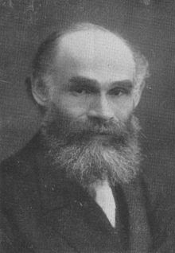
David Baron 1885-1926

Slide 13
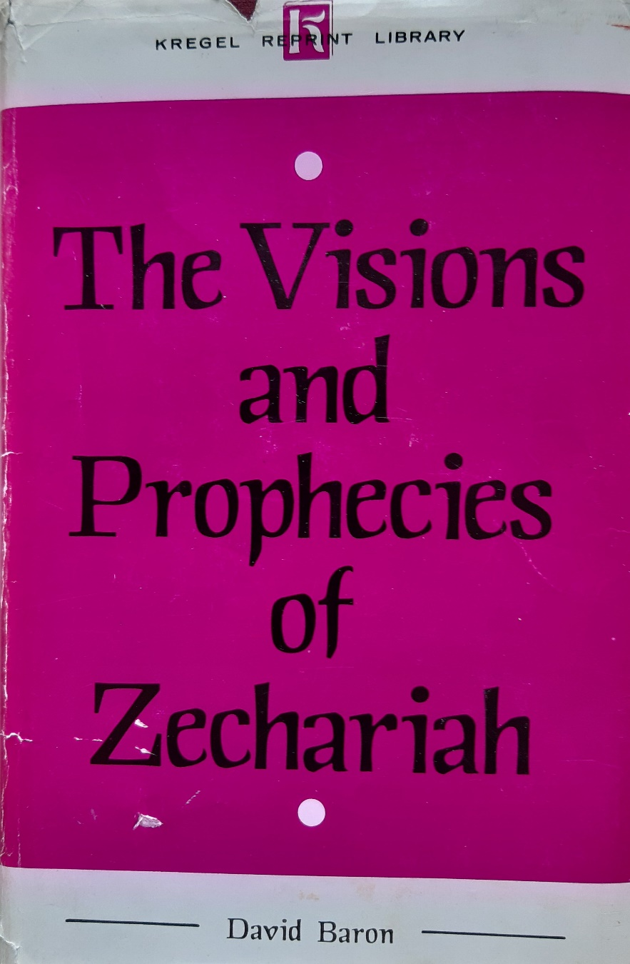
Composed 1907-1918

Slide 14
Contents
1:1-6 Introduction:
Historical perspective and
promise
a) Eight visions in one night
1:7-17 God’s concern and plan for Jerusalem
1:18-21 Judgement on her enemies
2:1-6 A prosperous and protected city
Application 2:7-13: Flee from Babylon to Jerusalem

Slide 15
Contents
3:1-10 Joshua purified and clothed
4:1-14 Zerubbabel anointed for
his calling
5:1-4 The flying scroll: purging sinners from the Land
5:5-11 The flying basket: removing iniquity from the Land
6:1-8 Four chariots of judgement on the nations
A prophetic sign: 6:11-15 Joshua the high priest is crowned

Slide 16
Contents
b) The nature of True Religion – the Heart
Chapter 7 False feasts and fasts
Outcome: Scattered people and desolate land
Chapter 8 True feasts and fasts
Outcome: Gathered people and productive land
Joy and gladness and witness to the presence of God

Slide 17
Contents
c) Israel and the Nations
First Oracle: Chapters 9 - 11
9 A Greek Emperor and the Prince of Peace
10 The Shepherd King
11 The true Shepherd rejected

Slide 18
c) Israel and the Nations
Second Oracle: Chapters 12 - 14
Disaster, deliverance and repentance
Cleansing; the wounded Shepherd; My people/my God
14 Return of the King ; Deliverance, Judgement and Celebration

Slide 19
Haggai
1: 1-11 “[Re]set your heart” v5, 7
A call for radical change in attitude
and activity
My house has priority over yours
Building your houses without blessing
1:12-15 The peoples’ response - reverence and obedience
God’s response - His presence and inspiration
2:2-9 (2 months later) Encouragement
“I am with you”
Don’t be put off by appearances
God’s great long-term plans – shaking, glory and peace

Slide 20
Zechariah’s opening prophecy
In the eighth month, (one month later) in the second
year of Darius, Yahweh’s word came to Zechariah
the son of Berechiah, the son of Iddo, the prophet, saying, “Yahweh was very displeased with your fathers. Therefore tell them: The LORD of Hosts says:
‘Return to me,’ says The LORD of Hosts, ‘and I will
return to you,’ says The LORD of Hosts.

Slide 21
Don’t you be like your fathers, to whom the
former prophets proclaimed, saying: The
LORD of Hosts says, ‘Return now from
your evil ways, and from your evil doings;’
but they didn’t hear, nor listen to me, says Yahweh.
Your fathers, where are they? And the prophets, do they live forever? But my words and my decrees, which I commanded my servants the prophets, didn’t they overtake your fathers?
“Then they repented and said, ‘Just as the LORD of Hosts determined to do to us, according to our ways, and according to our practices, so he has dealt with us.’” 1:1-6

Slide 22
Recognise Repent and Return
A call to repentance 1:1-6
(1 month later) “Return to Me,
declares the LORD of Hosts”
Do not be like your fathers – deaf and disobedient
Learn from their experience
Return to Me that I may return to you
They recognised and repented

Slide 23
Haggai (conclusion)
(1 month later)
2:10-14 The problem of uncleanness
(unresolved)
2:15-19 Consider (set your heart):
if your attitudes and intentions are right, God will deal with that problem.
(Later on the same day)
2: 20-22 Shaking, and victory over the nations
2:23 Zerubbabel a signet ring on God’s hand

Slide 24
Zerubbabel’s problem father
“As I live,” says Yahweh, “though Coniah [Jehoiakin] the son of Jehoiakim king of
Judah were the signet on my right hand,
I would still pluck you from there. I would
give you into the hand of those who seek
your life, and into the hand of them of whom
you are afraid, even into the hand of Nebuchadnezzar king of Babylon ...
Yahweh says, “Record this man as childless, a man who will not prosper in his days; for no more will a man of his offspring prosper, sitting on David’s throne, and ruling in Judah.” Jer. 22:24-25, 30

Slide 25
Zerubbabel becomes a sign
of the Messiah
In that day, says Yahweh of Hosts, I will
take you, Zerubbabel, my servant, the
son of Shealtiel,’ says Yahweh, ‘and [I]
will make you as a signet, for I have
chosen you,’ says Yahweh of Hosts.”
Haggai 2:23
His loyalty to the Lord is rewarded
Yahweh’s word came to me, saying, “The hands of Zerubbabel have laid the foundation of this house. His hands shall also finish it.” Zech. 4: 9,

Slide 26
The Ultimate Shaking
“Yet once more I will shake not only the earth,
but also the heavens.” This phrase, “Yet once
more” signifies the removing of those things
that are shaken, as of things that have been
made, that those things which are not shaken
may remain. Therefore, receiving a Kingdom
that can’t be shaken, let’s have grace, through
which we serve God acceptably, with reverence and awe, for our God is a consuming fire. Heb. 12:26-29

Slide 27
The Final Page
Then Yahweh will go out and fight against
those nations, as when he fought in the day
of battle. His feet will stand in that day on the
Mount of Olives, which is before Jerusalem
on the east; and the Mount of Olives will be
split in two, from east to west, making a very
great valley ... Yahweh will be King over all the
earth. In that day Yahweh will be one, and his
name one ... Judah also will fight at Jerusalem;
and the wealth of all the surrounding nations will
be gathered together: gold, and silver, and clothing,
in great abundance ...

Slide 28
The Final Page
It will happen that everyone who is left of all
the nations that came against Jerusalem will
go up from year to year to worship the King,
The LORD of Hosts, and to keep the Feast of Tabernacles ... In that day there will be on
the bells of the horses, “HOLY TO YAHWEH”;
and the pots in Yahweh’s house will be like the bowls before the altar. Yes, every pot in Jerusalem and in Judah will be holy to The LORD of Hosts.
Zech. 14: 3-4, 9, 14, 16, 20-21.

