Slide 1
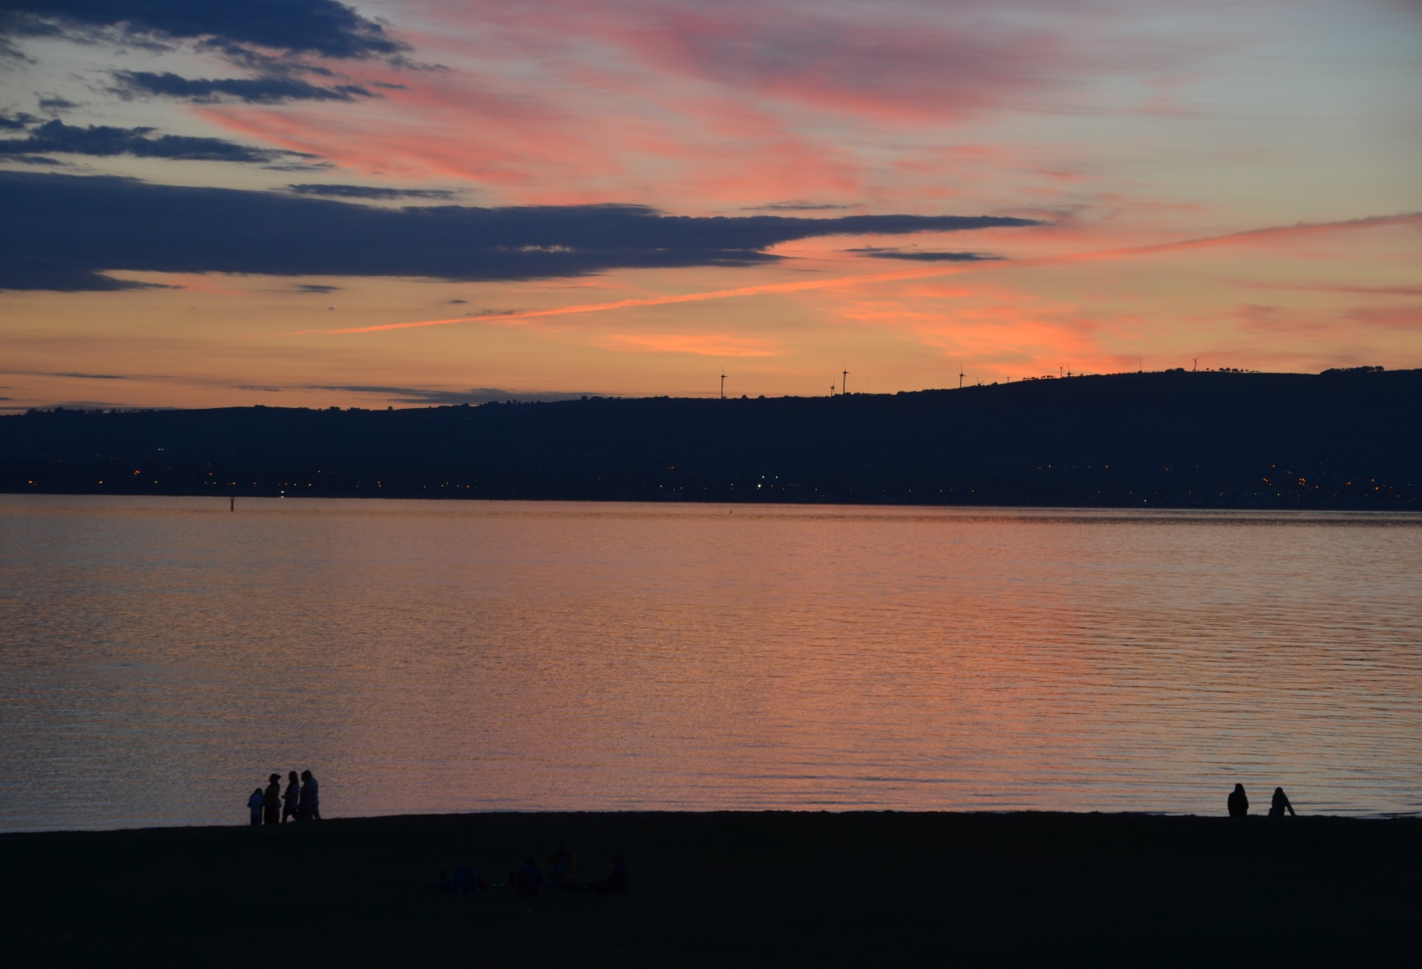
When I consider your heavens, the work of your fingers, the moon and the stars, which you have ordained; what is man, that you think of him? What is the son of man, that you care for him? Ps. 8:3-4

Slide 2
David’s Dilemma
He longed for his exiled son
He could not devise a safe way to bring him home
It was not possible for him to die in place of his son
The woman said, “Why then have you devised such a thing against the people of God? For in speaking this word the king is as one who is guilty, in that the king does not bring home again his banished one. For we must die, and are like water spilled on the ground, which can’t be gathered up again; neither does God take away life, but devises means, that he who is banished not be an outcast from him. 2 Sam. 14:13-14

Slide 3
The Cross
Place of Oneness and Obedience and Glory

Slide 4
Akedah – The Binding of Isaac Gen 22:1-19
After these things, God tested Abraham, and said to him, “Abraham!” He said, “Here I am. He said, “Now [please] take your son, your only son, Isaac, whom you love, and go into the land of Moriah. Offer him there as a burnt offering on one of the mountains which I will tell you of.” Abraham rose early in the morning, and saddled his donkey; and took two of his young men with him, and Isaac his son. He split the wood for the burnt offering, and rose up, and went to the place of which God had told him.

Slide 5
On the third day Abraham lifted up his eyes, and
saw the place far off. Abraham said to his young men,
“Stay here with the donkey. The boy [young man] and I
will go over there. We will worship, and come back
to you.”Abraham took the wood of the burnt offering
and laid it on Isaac his son. He took in his hand the fire and the knife. They both went together. Isaac spoke to Abraham his father, and said, “My father?” He said, “Here I am, my son.” He said, “Here is the fire and the wood, but where is the lamb for a burnt offering?” Abraham said, “God will provide [to/for] himself the lamb for a burnt offering, my son.” So they both went together.

Slide 6
They came to the place which God had told him of.
Abraham built the altar there, and laid the wood in
order, bound Isaac his son, and laid him on the altar,
on the wood. Abraham stretched out his hand, and
took the knife to kill his son.
The Angel of the LORD called to him out of the sky, and said, “Abraham, Abraham!” He said, “Here I am.” He said, “Don’t lay your hand on the boy or do anything to him. For now I know that you fear God, since you have not withheld your son, your only son, from me.” your only son, from me.”

Slide 7
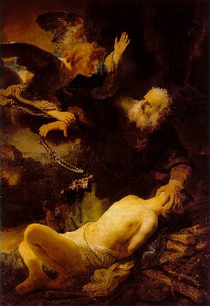

Slide 8
Abraham lifted up his eyes, and looked, and saw that
behind him was a ram caught in the thicket by his
horns. Abraham went and took the ram, and offered
him up for a burnt offering instead of his son.
Abraham called the name of that place “the LORD Will Provide”. As it is said to this day, “On The LORD’s mountain, it will be provided.”

Slide 9
The Angel of the LORD called to Abraham a second
time out of the sky, and said, “‘I have sworn by
myself,’ says the LORD, ‘because you have done
this thing, and have not withheld your son, your only son, that I will bless you greatly, and I will multiply your offspring greatly like the stars of the heavens, and like the sand which is on the seashore. Your offspring will possess the gate of his enemies. All the nations of the earth will be blessed by your offspring, because you have obeyed my voice.’”
So Abraham returned to his young men, and they rose up and went together to Beersheba.

Slide 10
The promise is unconditional
and irrevocable
For when God made a promise to Abraham, since
he could swear by no one greater, he swore
by himself, saying, “Surely blessing I will bless you,
and multiplying I will multiply you.”
Thus, having patiently endured, he obtained the promise. For men indeed swear by a greater one, and in every dispute of theirs the oath is final for confirmation.

Slide 11
This incident was prophetic of Jesus
By faith, Abraham, being tested, offered up Isaac. Yes, he who had gladly received the promises was offering up his one and only son, to whom it was said, “Your offspring will be accounted as from Isaac,” concluding that God is able to raise up even from the dead. Figuratively speaking, he also did receive him back from the dead. Heb. 11:17-19
For God so loved the world, that he gave his one and only Son, that whoever believes in him should not perish, but have eternal life. Jn.3:16
Your father Abraham rejoiced to see my day. He saw it, and was glad.” Jn. 8:56

Slide 12
In this way God, being determined to show
more abundantly to the heirs of the promise
[to Abraham] the immutability of his counsel,
interposed with an oath, that by two immutable
things, in which it is impossible for God to lie, we
may have a strong encouragement, who have fled
for refuge to take hold of the hope set before us.
This hope we have as an anchor of the soul, a hope both sure and steadfast and entering into that which is within the veil; where as a forerunner Jesus entered for us, having become a high priest forever after the order of Melchizedek. Heb. 6:13-20

Slide 13
The Law is not the answer
For the law, having a shadow of the good to come, not
the very image of the things, can never with the same
sacrifices year by year, which they offer continually,
make perfect those who draw near. Or else wouldn’t they
have ceased to be offered, because the worshippers,
having been once cleansed, would have had no
more consciousness of sins.
But in those sacrifices there is a yearly reminder of sins.
For it is impossible that the blood of bulls and goats should
take away sins. Heb. 10:1-4

Slide 14
Jesus freely offered Himself
as the solution
Therefore when he comes into the world, he
[the Messiah] says, “You didn’t desire sacrifice and
offering, but you prepared a body for me. You had no
pleasure in whole burnt offerings and sacrifices for sin.
Then I [the Messiah] said, ‘Behold, I have come (in the scroll of the book it is written of me) to do your will, O God.’” … by which will we have been sanctified through the offering of the body of Jesus Christ once for all. Heb. 10: 5-10

Slide 15
Fully God and Fully Man in one Person
The Word became flesh, and lived amongst us.
We saw his glory, such glory as of the one and only
Son of the Father, full of grace and truth. Jn. 1:14
Christ Jesus who, existing in the form of God, didn’t consider equality with God a thing to be grasped, but emptied himself, taking the form of a servant, being made in the likeness of men. And being found in human form, he humbled himself, becoming obedient to the point of death, yes, the death of the cross. Phil. 2:5-8

Slide 16
Fully God
In the beginning was the Word, and the Word was
with God, and the Word was God. The same was
in the beginning with God. All things were made through him. Without him, nothing was made that has been made. Jn. 1:1-3
Jesus said to them, “Most certainly, I tell you, before Abraham came into existence, I AM.” Jn. 8:58
I and the Father are one. Jn.10:30

Slide 17
Fully God
God, having in the past spoken to the fathers
through the prophets at many times and in various
ways, has at the end of these days spoken to us by
his Son, whom he appointed heir of all things, through
whom also he made the worlds. His Son is the radiance of his glory, the very image of his substance, and upholding all things by the word of his power, who, when he had by himself purified us of our sins, sat down on the right hand of the Majesty on high …
when he [God] brings in the firstborn into the world he says, “Let all the angels of God worship him.” Heb. 1:1-3, 6.

Slide 18
Fully man
Since then the children have shared in flesh and
blood, he also himself in the same way partook of
the same. Heb. 2: 14
Therefore he was obligated in all things to be made like his brothers, that he might become a merciful and faithful high priest in things pertaining to God, to make atonement for the sins of the people. For in that he himself has suffered being tempted, he is able to help those who are tempted. Heb. 2: 17-18

Slide 19
Having then a great high priest who has passed
through the heavens, Jesus, the Son of God,
let’s hold tightly to our confession. For we don’t
have a high priest who can’t be touched with the
feeling of our infirmities, but one who has been
in all points tempted like we are, yet without
sin. Heb.4: 14-16

Slide 20
A man and also a Jew
But when the fullness of the time came, God sent out his Son, born to a woman, born under the law, that he might redeem those who were under the law, that we might receive the adoption of children. Gal. 4:4-5

Slide 21
A Torah-observant Jewish man
When eight days were fulfilled for the circumcision
of the child, his name was called Jesus, which was
given by the angel before he was conceived in
the womb. When the days of their purification
according to the law of Moses were fulfilled, they
brought him up to Jerusalem, to present him to the
Lord (as it is written in the law of the Lord, “Every
male who opens the womb shall be called holy
to the Lord”), and to offer a sacrifice according to
that which is said in the law of the Lord,
“A pair of turtledoves, or two young pigeons.” Lk. 2:21-24

Slide 22
From the cradle…
She gave birth to her firstborn son. She wrapped him
in bands of cloth, and laid him in a [stone] feeding trough, because there was no room for them in the inn. Lk. 2:7
They [wise men] came into the house and saw the
young child with Mary, his mother, and they fell down and worshipped him. Opening their treasures, they offered to him gifts: gold, frankincense, and myrrh. Matt.2:11

Slide 23
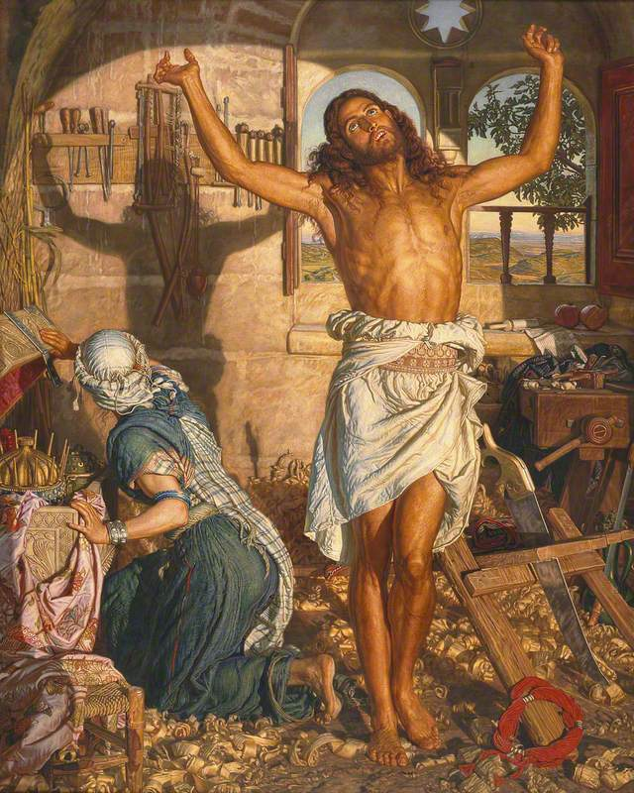
The Shadow of Death
he Shadow of Death
William Holman Hunt (1827–1910)
Manchester Art Gallery
Mary glances round from her treasure box containing myrrh, a gift from the Magi.
The Shadow of Death

Slide 24
…to the cross
After these things, Joseph of Arimathaea, being a
disciple of Jesus, but secretly for fear of the Jews,
asked of Pilate that he might take away Jesus’ body.
Pilate gave him permission. He came therefore and
took away his body. Nicodemus, who at first came to
Jesus by night, also came bringing a mixture of
myrrh and aloes, about a hundred Roman pounds.
So they took Jesus’ body, and bound it in strips of linen
with the spices, as the custom of the Jews is to bury.
Now in the place where he was crucified there was a garden. In the garden was a new tomb in which no man had ever yet been laid. Then because of the Jews’ Preparation Day (for the tomb was near at hand) they laid Jesus there. John 19:38-42

Slide 25
Jesus embraced his destiny from the start
Jesus answered them, “Destroy this temple, and in
three days I will raise it up.” The Jews therefore said,
“It took forty-six years to build this temple!
Will you raise it up in three days?” But he spoke of the
temple of his body. When therefore he was raised
from the dead, his disciples remembered that he
said this, and they believed the Scripture, and
the word which Jesus had said. Jn. 2:19-22

Slide 26
An early reference to the cross
As Moses lifted up the serpent in the wilderness,
even so must the Son of Man be lifted up, that whoever believes in him should not perish,
but have eternal life.
Jn. 3:15

Slide 27
Father and the Son acted as one
- Jesus was not a victim
I am the good shepherd. I know my own, and I’m
known by my own … even as the Father knows
me, and I know the Father. I lay down my life
for the sheep. Therefore the Father loves me,
because I lay down my life, that I may take it
again. No one takes it away from me, but I lay
it down by myself. I have power to lay it down,
and I have power to take it again.
I received this commandment from my Father.” Jn. 10:14-18

Slide 28
The Father determined the hour of destiny
Jesus therefore said to them [his brothers], “My time
has not yet come, but your time is always ready
… I know him, because I am from him [God], and
he sent me.” Jn. 7:6
They [people] sought therefore to take him; but no one
laid a hand on him, because his hour had not yet come.
Jn. 7: 28-30.

Slide 29
“I and the Father are one.”
Therefore the Jews took up stones again to stone
him. Jesus answered them, “I have shown you many
good works from my Father. For which of those works
do you stone me?”
The Jews answered him, “We don’t stone you for a
good work, but for blasphemy: because you, being
a man, make yourself God.”… believe the works, that
you may know and believe that the Father is in me,
and I in the Father.”
They sought again to seize him, and he went out
of their hand.
Jn. 10:30-33, 38-39.

Slide 30
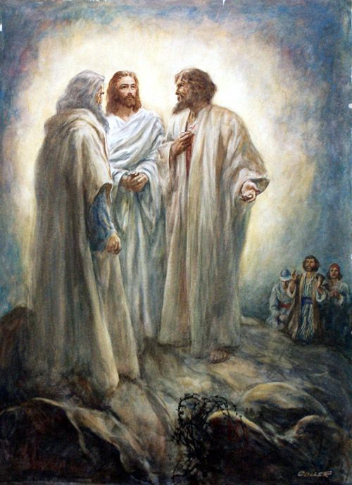
Henry Coller 1948

Slide 31
Declaration and Transfiguration
The Son of Man must suffer many things, and be
rejected by the elders, chief priests, and scribes,
and be killed, and the third day be raised up.” Lk. 9:22
About eight days after these sayings,
he took with him Peter, John, and James, and went up
onto the mountain to pray. As he was praying, the
appearance of his face was altered, and his clothing
became white and dazzling.
Behold, two men were talking with him, who were Moses
and Elijah who appeared in glory, and spoke of his
departure [Exodus], which he was about to accomplish at Jerusalem. Lk. 9:28-31

Slide 32
The Father’s affirmation
Now Peter and those who were with him were
heavy with sleep, but when they were fully awake,
they saw his glory, and the two men who stood with him. As they were parting from him, Peter said to
Jesus, “Master, it is good for us to be here. Let’s make three tents: one for you, one for Moses, and one for Elijah,” not knowing what he said. While he said these things, a cloud came and overshadowed them, and
they were afraid as they entered into the cloud. A
voice came out of the cloud, saying, “This is my
beloved Son. Listen to him!” When the voice came,
Jesus was found alone. Lk 9:28-31

Slide 33
Facing towards Jerusalem
It came to pass, when the days were near that he
should be taken up, he intently set his face to go to
Jerusalem and sent messengers before his face.
They went and entered into a village of the Samaritans,
so as to prepare for him. They didn’t receive him,
because he was travelling with his face
set towards Jerusalem. Lk. 9:51-53
But I have a baptism to be baptised with, and how
distressed I am until it is accomplished! Lk. 12:50

Slide 34
Aware of what was involved
The Lord GOD has opened my ear. I was not
rebellious. I have not turned back. I gave my
back to those who beat me, and my cheeks to
those who plucked off the hair. I didn’t hide
my face from shame and spitting. For the Lord
GOD will help me.
Therefore I have not been confounded. Therefore
I have set my face like a flint, and I know that
I won’t be disappointed. Is. 50:5-7

Slide 35
Another prediction of His death
They went out from there, and passed through
Galilee. He didn’t want anyone to know it. For he
was teaching his disciples, and said to them,
“The Son of Man is being handed over to the hands
of men, and they will kill him; and when he is killed,
on the third day he will rise again.”
But they didn’t understand the saying, and were
afraid to ask him. Mk. 9:30-32

Slide 36
A third and graphic description of His death
They were on the way, going up to Jerusalem;
and Jesus … again took the twelve, and began to tell
them the things that were going to happen to him.
“Behold, we are going up to Jerusalem. The Son of Man
will be delivered to the chief priests and the scribes.
They will condemn him to death, and will deliver him
to the Gentiles. They will mock him, spit on him, scourge him, and kill him. On the third day he will rise again.” Mk. 10:32-34

Slide 37
Father and the Son to be glorified together
Jesus answered them, “The time has come for the
Son of Man to be glorified. Jn. 12:23
“Now my soul is troubled. What shall I say? ‘Father,
save me from this time?’ But I came to this time for
this cause. Father, glorify your name!”
Then a voice came out of the sky, saying, “I have both
glorified it, and will glorify it again.” Jn. 12:27-28

Slide 38
Two pictures of the cross
Most certainly I tell you, unless a grain of wheat
falls into the earth and dies, it remains by
itself alone. But if it dies, it bears much fruit. He
who loves his life will lose it. He who hates his
life in this world will keep it to eternal life. Jn. 12:24
Now is the judgement of this world. Now the
prince of this world will be cast out.
And I, if I am lifted up from the earth, will draw
all people to myself.” But he said this, signifying by
what kind of death he should die. Jn. 12:31-33

Slide 39
Father and the Son united in purpose
Now before the feast of the Passover, Jesus,
knowing that his time had come that he would
depart from this world to the Father, having
loved his own who were in the world, he loved
them to the end. During supper, the devil having
already put into the heart of Judas Iscariot,
Simon’s son, to betray him, Jesus, knowing
that the Father had given all things into his
hands, and that he came from God, and was
going to God … Jn. 13:1-3

Slide 40
Past and Present Glory
Jesus said these things, then lifting up his eyes to heaven, he said, “Father, the time has come. Glorify your Son, that your Son may also glorify you; even
as you gave him authority over all flesh, so he will
give eternal life to all whom you have given him.
This is eternal life, that they should know you, the only true God, and him whom you sent, Jesus Christ.
I glorified you on the earth. I have accomplished
the work which you have given me to do.
Jn. 17: 1- 4.

Slide 41
Future Glory
Now, Father, glorify me with your own self with the glory which I had with you before the world existed. I revealed your name to the people whom you have given me out of the world. They were yours, and you have given them to me. They have kept your word. Jn. 17:6
The glory which you have given me, I have given to them.
Jn. 17:22
Father, I desire that they also whom you have given me be with me where I am, that they may see my glory, which you have given me, for you loved me before the foundation of the world. Jn. 17:24.

