Slide 1
The Visions and Prophecies of Zechariah
Session 7

Slide 2
Structure of Chapters 9-11
Chapter 9
Judgement on local nations 1-7
Protection for Jerusalem 8
The coming Messiah King 9-10
Restoration and Salvation 11-17
Chapter 10
Regathering Israel
Victory and strength
Chapter 11
Coming judgement
False shepherds
Rejected Shepherd
Scattered sheep
Foolish and worthless shepherd

Slide 3
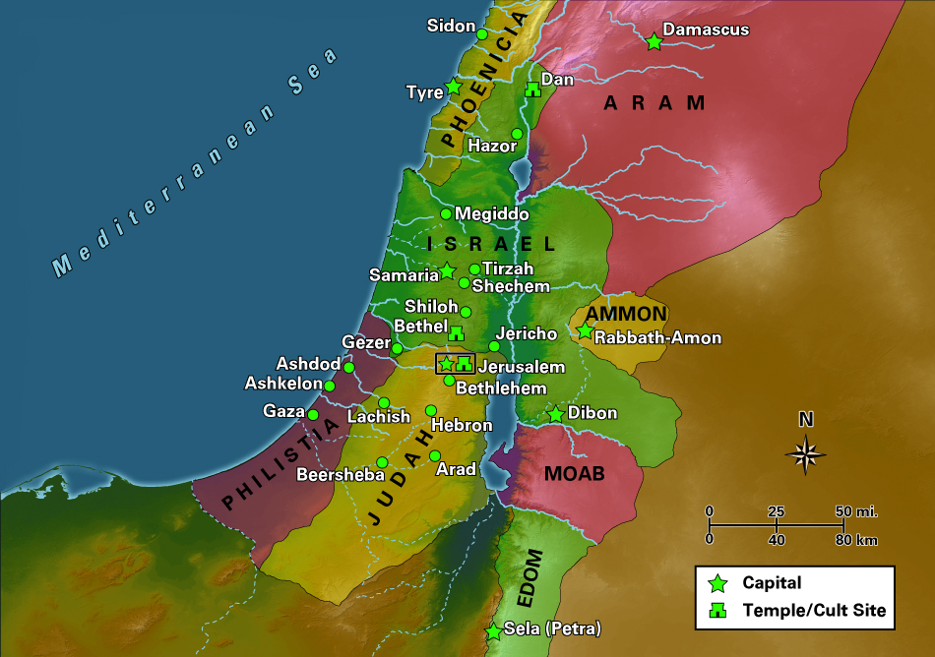

Slide 4
Judgement on the Nations: North
The burden of the word of the Lord is against
the land of Hadrach and will come to rest on Damascus - (for the eye of man [heb. adam] and all the tribes of
Israel are on the Lord) - and on Hamath too, which borders on it, and on Tyre and Sidon, though they are very skilful. Zech 9:1-2
The prophecy, when fulfilled, should cause people to recognise
the hand of God in the affairs of men.

Slide 5
Tyre - Epitome of Pride and Materialism
Tyre has built herself a stronghold; she has heaped up silver like dust, and gold like the dirt of the streets. But the Lord will take away her possessions [dispossess her] and He will smite her power [wealth] on the sea, and she will be consumed by fire. 9:3-4
Who has planned this against Tyre, the giver of crowns, whose merchants are princes, whose traders are the honourable of the earth? The LORD of Hosts has planned it, to stain the pride of all glory, to bring into contempt all the honourable of the earth. Isaiah 23:8

Slide 6
Yahweh’s word came again to me, saying, “Son of man,
tell the prince of Tyre, ‘The Lord Yahweh says:
“Because your heart is lifted up, and you have said,
‘I am a god, I sit in the seat of God, in the middle of the
seas;’ yet you are man, and not God, though you set your heart as the heart of God -behold, you
are wiser than Daniel; there is no secret that is hidden from
you; by your wisdom and by your understanding you have
gotten yourself riches, and have gotten gold and silver into
your treasuries; by your great wisdom and by your trading you
have increased your riches, and your heart is lifted up because of your riches -” “‘therefore the Lord Yahweh says: “Because you have set your heart as the heart of God, therefore, behold, I will bring strangers on you,
the terrible of the nations. They will draw their swords against the beauty
of your wisdom. They will defile your brightness. They will bring you down
to the pit. You will die the death of those who are slain in the heart of
the seas. Will you yet say before him who kills you, ‘I am God’? But you are man, and not God, in the hand of him who wounds you. You will die the death of the uncircumcised by the hand of strangers; for I have spoken it,” says the Lord Yahweh.’” Ezek. 28:1-10

Slide 7
A New Emperor - Alexander
The background to chapters 9 & 10
Daniel 605-539 BC
Zechariah’s prophecies 518-522 BC
The conquest of Tyre 332 BC
Assyria failed for 5 years and Babylon for 13 years but -
Tyre fell to Alexander after siege lasting seven months

Slide 8
Tyre is Judged
In their wailing they will take up a lamentation for you,
and lament over you, saying, ‘Who is there like Tyre, like her who is brought to
silence in the middle of the sea?’ When your wares went out of the seas,
you filled many peoples. You enriched the kings of the earth with the
multitude of your riches and of your merchandise. In the time that you were broken by the seas,
in the depths of the waters your merchandise
and all your company fell within you. All the inhabitants of the islands are astonished at you, and their kings are horribly afraid.
They are troubled in their face. The merchants among the peoples hiss at you. You have become a terror, and you will be no more.”’” Ezek. 27:32-36

Slide 9
Alexander conquered Persia but Perished
As I was considering, behold, a male goat came from the west over the surface of the whole earth, and didn’t touch the ground. The goat had a notable horn between his eyes. He came to the ram that had the two horns, which I saw standing before the river, and ran on him in the fury of his power. I saw him come close to the ram, and he was moved with anger against him, and struck the ram, and broke his two horns. There was no power in the ram to stand before him; but he cast him down to the ground, and trampled on him. There was no one who could deliver the ram out of his hand. The male goat magnified himself exceedingly. When he was strong, the great horn was broken; and instead of it there came up four notable horns toward the four winds of the sky. Dan. 8:5-8

Slide 10
The route of Alexander’s conquests
Damascus
Tyre and Sidon
Philistia
Egypt
Jerusalem on northward journey

Slide 11
Judgement on the Nations: South
Ashkelon will see it and fear; Gaza will writhe in agony, and Ekron too, for her hope will wither. Gaza will lose her king [Batis] and Ashkelon will be deserted.
A mongrel people (?foreigner, ignoble birth) will occupy Ashdod,and I will put an end to the pride of the Philistines.
I will take the blood from their mouths, the forbidden food [abominations] from between their teeth (idolatrous sacrificial meat). Those who are left will belong to our God and become a clan in Judah, and Ekron will be like the Jebusites*. Zech. 9:5-7
* See 1Chron. 21:18-30

Slide 12
God protected Jerusalem
And I will encamp about my house
[Temple] against the army, that none pass through or return; and no oppressor [taskmaster] shall pass through them anymore; for now I have seen with my eyes. Zech. 9:5-8
Yahweh said, “I have surely seen the affliction of my people who are in Egypt, and have heard their cry because of their taskmasters, for I know their sorrows. Exodus 3:7

Slide 13
A Different King – Messiah – 1st Coming
Rejoice greatly, Daughter Zion
Shout, Daughter Jerusalem! See, your king comes to you,
Righteous, having salvation [passive form], Lowly [poor, afflicted]* and riding on a donkey, on a colt, the foal of a donkey [peaceful].
Zech. 9:9
Your King – Israel’s King: Luke 1:30-33, 69-70; John 1:49; 19:19
To you – from elsewhere: John 18:36-37
This took place to fulfil what was spoken through the prophet:
“Say to Daughter Zion, ‘See, your king comes to you, gentle and riding on a donkey, and on a colt, the foal of a donkey.’” Matt. 21:4-5
* See Isaiah 53

Slide 14
A Different King – Messiah – 2nd Coming
I will cut off the chariot from Ephraim and the horse from Jerusalem, and the battle bow will be cut off. He will proclaim peace to the nations. His rule will
extend from sea to sea and from the River to the ends
of the earth. Zech. 9:10;
c.f. Psalm 72; Gen. 15:18; Micah 5:1-11; Isaiah 9:1-7.
Sing and rejoice, daughter of Zion; for, behold, I come, and I will dwell within you,’ says Yahweh. Zech. 2:10
Sing to Yahweh, for he has done excellent things! Let this be known in all the earth! Cry aloud and shout, you inhabitant of Zion; for the Holy One of Israel is great among you!” Isaiah 12:5-6
Zech. 14 describes the last and decisive conflict

Slide 15
Covenant Assurance
As for you also, because of the blood of your covenant, I have [will] set free your prisoners from the pit in which
is no water. Turn to the stronghold, you prisoners of hope! Even today I declare that I will restore double to you. For indeed I bend Judah as a bow for me. I have filled the bow with Ephraim; and I will stir up your sons, Zion, against your sons, Greece, and will make you like the sword of a mighty man. 9:10-13

Slide 16
Blood Covenants
Unconditional
It came to pass that, when the sun went down, and it was dark, behold, a smoking furnace and a flaming torch passed between these pieces. In that day Yahweh made a covenant with Abram, saying, “I have given this land to your offspring, from the river of Egypt to the great river, the river Euphrates.
Gen. 15:17-18
Conditional
My covenant shall be in your flesh for an everlasting covenant. The uncircumcised male who is not circumcised
in the flesh of his foreskin, that soul shall be cut off from his people. He has broken my covenant.” Gen. 17:13-14
Moses took the blood, and sprinkled it on the people, and said, “Look, this is the blood of the covenant, which Yahweh has made with you concerning all these words.” Exodus 24:8

Slide 17
The New Covenant
“Behold, the days come,” says Yahweh, “that I will make a new covenant with the house of Israel, and with the house of Judah. Jer. 31:31
He [Jesus] took the cup, gave thanks, and gave to them [the Jewish disciples], saying, “All of you drink it, for this is my blood of the new covenant, which is poured out for many* [Jews and Gentiles] for the remission of sins. Matt. 26:27-28
* Isaiah 53: “the many”

Slide 18
Release for the Captives
As for you also, because of the blood of your covenant,
I have [will] set free your prisoners from the pit in
which is no water. 9:11
But this is a robbed and plundered people. All of them are
snared in holes, and they are hidden in prisons. They
have become captives, and no one delivers, and a plunder,
and no one says, ‘Restore them!’ ... Who gave Jacob as
plunder, and Israel to the robbers? Was it not Yahweh, he
against whom we have sinned? For they would not walk in
his ways and they disobeyed his law. Therefore He poured the
fierceness of his anger on him ... Isaiah 22:22-25
... they took Joseph, and threw him into the pit. The pit was empty. There was no water in it. Gen. 37:24
I waited patiently for Yahweh. He turned to me, and heard my cry. He brought me up also out of a horrible pit, out of the miry clay. He set my feet on a rock, and gave me a firm place to stand. Psalm 40:1-2

Slide 19
Return and Restoration
Return to the stronghold, you prisoners of [the] hope! Even today I declare that I will restore double to you. 9:12
Return to the Land
Return to the LORD
For you have been a stronghold to the poor, a stronghold to the needy in his distress, a refuge from the storm, a shade from the heat, when the blast of the dreaded ones is like a storm against the wall. Isaiah 25:4

Slide 20
The Hope of Israel
Israel, hope in Yahweh, for there is loving kindness with Yahweh. Abundant redemption is with him. He will redeem Israel from all their sins. Psalm 130:7-8
But we were hoping that it was he who would redeem Israel. Luke 24:21
Now I stand here to be judged for the hope of the promise made by God to our fathers, which our twelve tribes, earnestly serving night and day, hope to attain. Concerning this hope I am accused by the Jews, King Agrippa! Why is it judged incredible with you, if God does raise the dead? Acts 26:6-8
For this cause therefore I [Paul] asked to see you and to speak with you. For because the hope of Israel I am bound with this chain.” Acts 28:20

Slide 21
The Ultimate Hope
For the creation waits with eager expectation for the children of God to be revealed. For the creation was subjected to vanity, not of its own will, but because of
him who subjected it, in hope that the creation itself
also will be delivered from the bondage of decay into
the liberty of the glory of the children of God. For we
know that the whole creation groans and travails in
pain together until now. Not only so, but ourselves also,
who have the first fruits of the Spirit, even we ourselves groan within ourselves, waiting for adoption, the redemption of our body. For we were saved in hope,
but hope that is seen is not hope. For who hopes for
that which he sees? But if we hope for that which we
don’t see, we wait for it with patience.
Rom. 8:19-25

Slide 22
The Double Portion
Even today I declare that I will restore double to you 9:12
Israel is God’s firstborn son
You shall tell Pharaoh, ‘Yahweh says, Israel is my son,
my firstborn, and I have said to you, “Let my son go, that
he may serve me;” Exodus 4: 22-23
Double in Punishment and in Blessing
[Jerusalem] has received of Yahweh’s hand double for all her sins. Isaiah 40:2
I will recompense their iniquity and their sin double, because they have polluted my land ... and have filled my inheritance with their abominations.” Jer. 16:18
Instead of your shame you will have double. Instead of dishonour, they will rejoice in their portion. Therefore in their land they will possess double. Everlasting joy will be to them. Isaiah 61:7

Slide 23
Dealing with the Oppressors
For indeed I bend Judah as a bow for me. I have filled the bow with Ephraim; and I will stir up
your sons, Zion, against your sons, Greece, and will make you like the sword of a mighty man. 9:10-13
A United Nation
Judah: The drawn bow
Ephraim: The arrows
Zion: The sword
Historical Fulfilment
See Daniel 8:9-14, 21-26; 11:29-35; 1 Maccabees chapters 1-4
The origin of the Feast of Hanukkah (Dedication) John 10:22-24
The Final showdown: Zechariah 14; Rev. 19:11-21

Slide 24
Total Victory and Celebration
Yahweh will be seen over them; and his arrow will flash like lightning; and the Lord Yahweh will blow the trumpet, and will go with whirlwinds of the south.
The LORD of Hosts will defend them; and they will destroy and tread down sling stones; and they will drink, and roar as through wine; and they will be filled like bowls, like the corners of the altar. 9:14-15

Slide 25
God’s Glory Displayed
The Shepherd who Protects and Provides
Yahweh their God will save them in that day as the flock of His people; for they are like the jewels of a crown, lifted on high over his land. For how great is His goodness, and how great is His beauty! Grain will make the young men flourish, and new wine the virgins. 9:16-17
Oh how great is your goodness, which you have laid up for those who fear you, which you have worked for those who take refuge in you ... Psalm 31:19
One thing I have asked of Yahweh, that I will seek after: that I may dwell in Yahweh’s house all the days of my life, to see Yahweh’s beauty, and to inquire in his temple. Psalm 27:4
Your eyes will see the king in his beauty. Isaiah 33:17

Slide 26
Yahweh is the only God
Ask of Yahweh rain in the spring time, Yahweh who makes storm clouds, and he gives rain showers to everyone for the plants in the field. For the teraphim have spoken vanity, and the diviners have seen a lie; and they have told false dreams. They comfort in vain. Zech. 10:1-2a
Are there any among the vanities of the nations that can cause rain? Or can the sky give showers? Aren’t you he, Yahweh our God? Therefore we will wait for you; for you have made all these things. Jer. 14:22

Slide 27
Obedience the Basis for Blessing
It shall happen, if you shall listen diligently to my commandments which I command you today, to love Yahweh your God, and to serve him with all your heart and with all your soul, that I will give the rain for your land in its season, the early rain and the latter rain, that you may gather in your grain, your new wine, and your oil. I will give grass in your fields for your livestock, and you shall eat and be full. Be careful, lest your heart be deceived, and you turn away to serve other gods and worship them; and Yahweh’s anger be kindled against you, and he shut up the sky so that there is no rain, and the land doesn’t yield its fruit; and you perish quickly from off the good land which Yahweh gives you. Deut. 11:13-17

Slide 28
Israel a sign to the Nations
“‘The Lord Yahweh says: “In the day that I cleanse you from all your iniquities, I will cause the cities to be inhabited and the waste places will be built. The land that was desolate will be tilled, instead of being a desolation in
the sight of all who passed by. They will say, ‘This land
that was desolate has become like the garden of Eden. The waste, desolate, and ruined cities are fortified and inhabited.’ Then the nations that are left around you will know that I, Yahweh, have built the ruined places, and planted that which was desolate. I, Yahweh, have spoken it, and I will do it.”
“‘The Lord Yahweh says: “For this, moreover, I will be inquired of by the house of Israel, to do it for them:
I will increase them with men like a flock. Ezek. 36:33-37

Slide 29
Physical and Spiritual Water
Yet listen now, Jacob my servant, and Israel, whom I have chosen. This is what Yahweh who made you, and formed
you from the womb who will help you says: “Don’t be afraid, Jacob my servant; and you, Jeshurun, whom I have chosen. For I will pour water on him who
is thirsty, and streams on the dry ground. I will pour
my Spirit on your descendants, and my blessing on
your offspring: and they will spring up among the
grass, as willows by the watercourses. One will say, ‘I am Yahweh’s;’ and another will be called by the name of Jacob; and another will write with his hand ‘to Yahweh,’ and honour the name of Israel.” Isaiah 44:1-5
Now on the last and greatest day of the feast, Jesus stood and cried out, “If anyone is thirsty, let him come to me and drink! He who believes in me, as the Scripture has said, from within him will flow rivers of living water.” But he said this about the Spirit, which those believing in him were to receive. For the Holy Spirit was not yet given, because Jesus wasn’t yet glorified. John 7:37-39

Slide 30
From Wandering Sheep to War Horse
Therefore they [the people] go their way [wandered] like sheep. They are oppressed, because there is no shepherd. My anger is kindled against the shepherds, and
I will punish the male goats; For the LORD of Hosts has visited his flock, the house of Judah ...
(This is a highly-condensed summary of Ezekiel 34:1-31
with further application in Zech. 11 and 13)
... and will make them as his majestic horse in the battle. Zech. 10:2b-3 (see 12:6-9)

